Slide 2
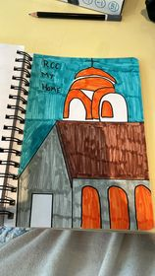

Slide 3
RCC My HOME
Place to belong to
Be cared for and care for others in times of need
To grow in our walk with God

Slide 5
^{Acts 1:8} But you will receive power when the Holy Spirit comes on you; and you will be my witnesses in Jerusalem, and in all Judea and Samaria, and to the ends of the earth.”

Slide 6
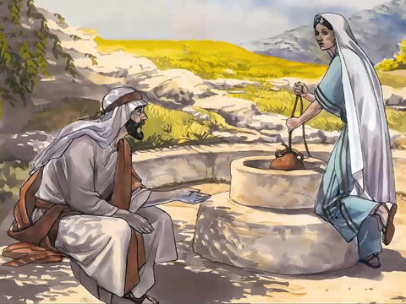

Slide 7
John 4 Jesus and the Samaritan Woman
“Come see a man who told me everything I ever did could this be the Christ?”
“Now we believe because
we have heard for our self.”

Slide 8
Peter spoke with power through the Holy Spirit
He began by sharing who Jesus is and why he came to earth to live and die and be resurrected and now he is in heaven
What does that mean to you and me living in 2024? - that is what we share

Slide 10
What did you
do over
the weekend?

Slide 11
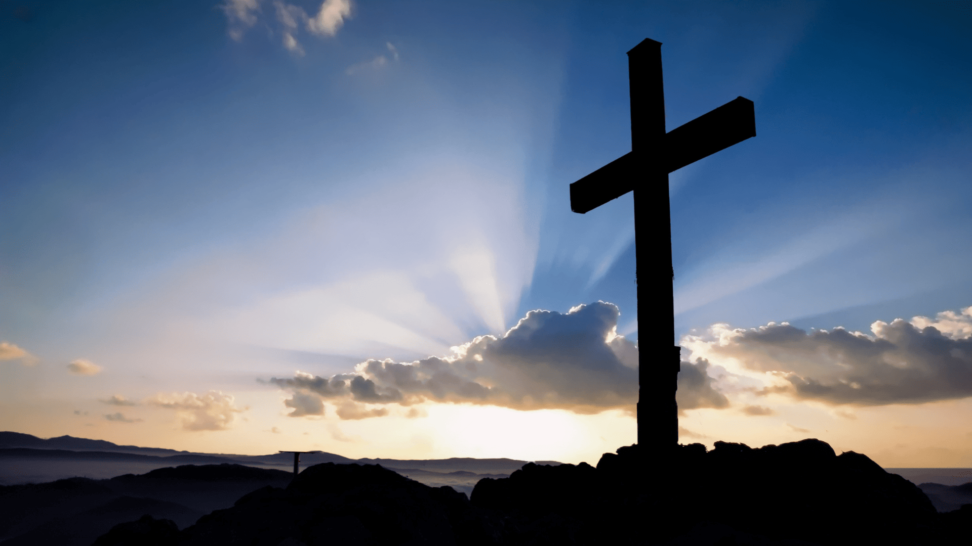
^{Romans} ^{10:13-17} ^{Message Bible}
Everyone who calls, “Help, God!” gets help.
But how can people call for help if they don’t know who to trust? And how can they know who to trust if they haven’t heard of the One who can be trusted?
And how can they hear if nobody tells them?
And how is anyone going to tell them, unless some is sent to do it? That’s why Scripture exclaims, A sight to take your breath away! Grand processions of people telling all the good things of God!

